Slide 1
MLA Format
Modern Language Association
Style for writing & formatting research papers

Slide 2
General Format
Double-space the text of your paper, use Times New Roman, size 12 font
Create a header that numbers all pages consecutively in the upper right-hand corner
In the upper left-hand corner of the first page, list:
Your name
Your instructor’s name
The course
The date

Slide 3
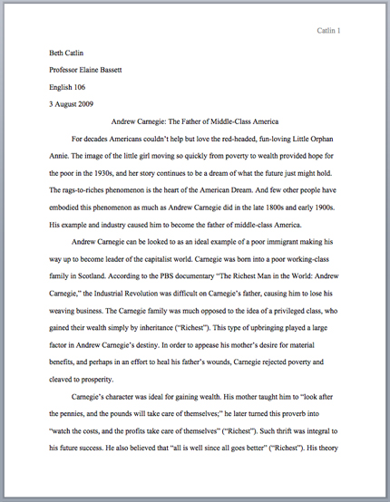

Slide 4
Quotations
Enclose the quotation with quotation marks
Provide the author and specific page citation in the text, and then include a complete reference on the Works Cited page
Punctuation marks such as periods, commas, and semicolons should appear after the parenthetical citation
Question marks and exclamation points should appear within the quotation marks if they are a part of the quoted passage, but after the parenthetical citation if they are a part of your text

Slide 5
Examples
According to some, dreams express “profound aspects of personality” (Foulkes 184), though some others disagree.
According to Foulkes’s study, dreams may express “profound aspects of personality” (184).
Is it possible that dreams may express “profound aspects of personality” (Foulkes 184)?

Slide 6
Adding or Omitting Words in Quotations
If you add a word or words in a quotation, you should put brackets around the words to indicate that they are not part of the original text
Jan Harold Brunvand, in an essay on urban legends, states, “some individuals [who retell urban legends] make a point of learning every rumor or tale” (78).
If you omit a word or words from a quotation, you should indicate the deleted word or words by using ellipsis marks, which are three periods (. . .)
In an essay on urban legends, Jan Harold Brunvard notes that “some individuals make a point of learning every recent rumor or tale . . . and in a short time a lively exchange of details occurs” (78).

Slide 7
Parenthetical Citation
In MLA style, referring to the works of others in your text is done by using what is known as parenthetical citation. Immediately following a quotation from a source or a paraphrase of a source’s ideas, you place the author’s name followed by a space and the relevant page number(s).
Any source information that you provide in-text must correspond to the source information on the Works Cited page

Slide 8
Parenthetical Citation
Author-page method: the author’s last name and the page number(s) from which the quotation or paraphrase is taken must appear in the text, and a complete reference should appear in your Works Cited page
The author’s name may appear either in the sentence itself or in parentheses following the quotation or paraphrase, but the page numbers should always appear in the parentheses, not in the text of your sentence.
Wordsworth stated that Romantic poetry was marked by a “spontaneous overflow of powerful feelings” (263).
Romantic poetry is characterized by the “spontaneous overflow of powerful feelings” (Wordsworth 263).

Slide 9
Wordsworth stated that Romantic poetry was marked by a “spontaneous overflow of powerful feelings” (263).
Romantic poetry is characterized by the “spontaneous overflow of powerful feelings” (Wordsworth 263).
Note that quotation marks do not go around the citation and the period goes after the citation.
Both citations in the examples above, (263) and (Wordsworth 263), tell readers that the information in the sentence can be located on page 263 of a work by an author named Wordsworth. If readers want more information about this source, they can turn to the Works Cited page, where, under the name Wordsworth, they would find more information.

Slide 10
In-text Citations with known author
For sources where the author is known, provide a signal word or phrase (usually the author’s last name) and a page number. If you provide the signal word/phrase in the sentence, you do not need to include it in the parenthetical citation.
Human beings have been described by Kenneth Burke as “symbol-using animals” (3).
Human beings have been described as “symbol-using animals” (Burke 3).

Slide 11
In-text Citations with unknown author
When a source has no known author, use a shortened title of the work instead of an author name. Place the title in quotation marks if it’s a short work, or italicized if it’s a longer work. Then provide a page number.
We see so many global warming hotspots in North America likely because this region has “more readily accessible climatic data and more comprehensive programs to monitor and study environmental change. . .” (“Impact of Global Warming” 6).

Slide 12
Works Cited Page
According to MLA style, you must have a Works Cited page at the end of your research paper. All entries in the Works Cited page must correspond to the works cited in your main text.
Basic Rules:
On a separate page at the end of your research paper
Label the page Works Cited and center it
Double space all citations, but do not skip spaces between entries
Indent the second and subsequent lines of citations

Slide 13
Listing Author Names
Entries are listed alphabetically by the author’s last name
Author names are written last name first; middle names or middle initials follow the first name
Burke, Kenneth
Levy, David M.
Wallace, David Foster

Slide 14
Sample Works Cited Page
Works Cited
“Aerospace Engineering and Engineering Mechanics.” UT Direct. 2006. 15 Feb. 2006.
http://www.ae.utexas.edu/what_is_aero.html
Brooke, Charles. “Swales Aerospace.” Swales Aerospace. 2003. 17 Feb. 2006.
http://www.swales.com/company/about_us.html
Kakut, Michio, and Jennifer Tracher. Nuclear Power: Both Sides. Cambridge: Harvard
UP, 1972

Slide 15
****IMPORTANT****
Note the following:
1.) Double-spacing (easily done by highlighting desired text and hitting Ctrl+2 on your keyboard)
2.) Indentation of all lines after the first line of the entry. (Sometimes you will need to hit “Enter” twice to pull the line away from the first line before indenting.)

Slide 16
http://www.quia.com/quiz/1997275.html

